Slide 1

TECHNICAL PRESENTATION
CO1 AT 3
Geferlin Boffy R (192571080)
CSA0504 DATABASE MANAGEMENT SYSTEMS

Slide 2
Q1. Create and present an ER Diagram for an Online Library System, explaining each component clearly.

Slide 3
Introduction to ER Diagram
ER (Entity Relationship) Diagram is a graphical representation of database structure.
It identifies:
Entities
Attributes
Relationships
Helps in designing an efficient database before implementation.
Real-world scenario: An Online Library allows members to search, borrow and return books.

Slide 4
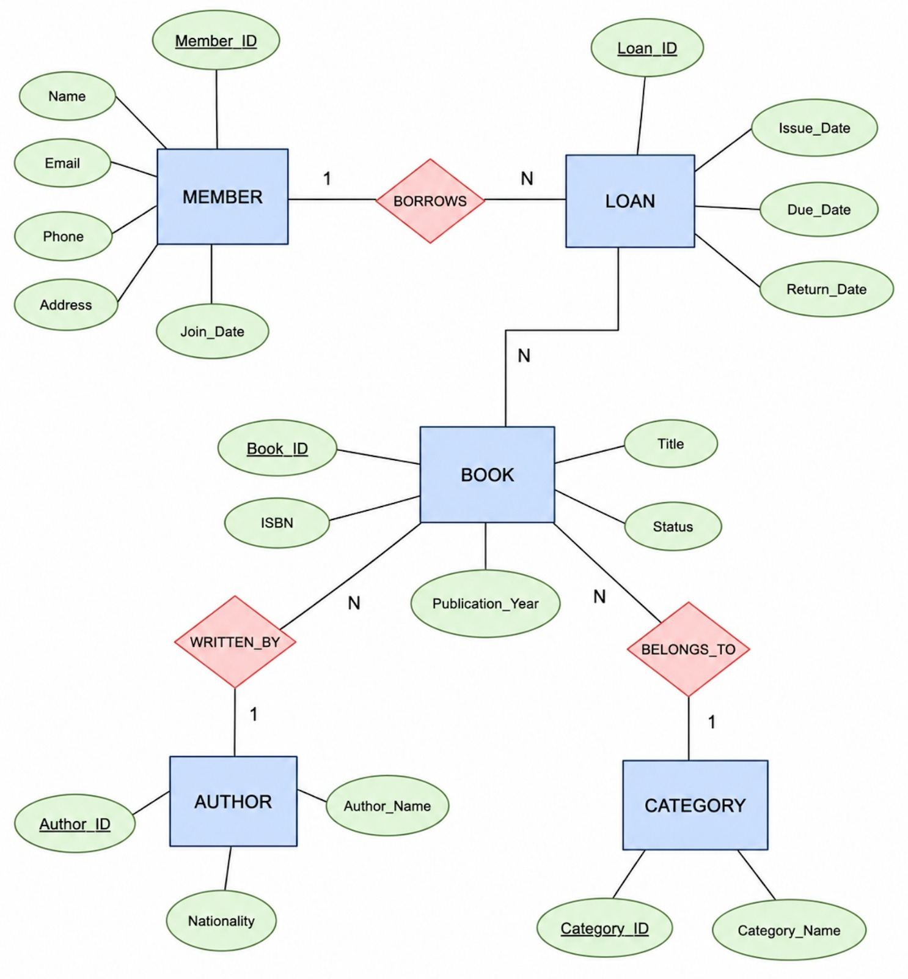
ER Diagram

Slide 5
Explanation
Entity: Represents real-world objects.
Example: Member, Book
Attributes: Describe entities.
Example:
Member → Name, Email
Book → Title, Author
Primary Key: Uniquely identifies each record.
Example:
MemberID ,BookID
Relationship: Connects entities.
Example:
Member borrows Book
Conclusion
ER diagram reduces redundancy and improves database organization.

Slide 6
Q2. Prepare a presentation on the EER Model demonstrating Generalization and Specialization with a University case study.

Slide 7
Introduction to EER Model
What is an EER Model?
The Enhanced Entity Relationship (EER) Model is an extension of the ER Model.
It is used to represent complex database structures.
It introduces concepts like generalization, specialization, and inheritance.
Key Concepts:
Superclass & Subclass
Generalization
Specialization
This version is concise and fits well on a single presentation slide.

Slide 8
Generalization and Specialization
Generalization
Generalization is the process of combining similar lower-level entities into a single higher-level entity called a Superclass.
It helps eliminate duplicate data by storing common attributes only once.
Example: Student + Faculty → Person
Specialization
Specialization is the process of dividing a higher-level entity into smaller, more specific entities called Subclasses.
Each subclass inherits the common attributes of the superclass and also has its own unique attributes.
Example: Person → Student, Faculty

Slide 9
Benefits and Applications of EER Model
Benefits of EER Model
Represents complex real-world relationships effectively.
Reduces data redundancy through inheritance.
Improves database organization and consistency.
Simplifies database design and maintenance.
Makes the database easier to expand and modify.
Applications
University Management System
Hospital Management System
Banking System
Employee Management System
E-commerce Database

Slide 10
Q3.Present the concept of Data Independence (Logical and Physical) and its significance in DBMS Architecture.

Slide 11
Data Independence
What is Data Independence?
Data Independence is the ability to modify the database structure without affecting application programs.
It allows changes at one level of the database without impacting other levels.
It helps in making the database flexible, efficient, and easier to maintain.
There are two types of data independence:
Logical Data Independence
Physical Data Independence

Slide 12
Types of Data Independence
1. Physical Data Independence
Refers to changes in the physical storage of the database without affecting the logical structure.
Examples include changing file organization, indexing, or storage devices.
Users and application programs remain unaffected.
2. Logical Data Independence
Refers to changes in the logical structure of the database without affecting user applications.
Examples include adding new attributes, tables, or modifying relationships.
Ensures applications continue to work without modification.

Slide 13
Importance
Benefits
Easier maintenance
Better security
Faster database updates
Lower development cost
High flexibility
Example
Changing storage location does not affect users using the database.

Slide 14
Q4. Deliver a technical presentation on the software components of a DBMS explaining Query Processor, Storage Manager and Transaction Manager.

Slide 15
Introduction to DBMS Software Components
What are DBMS Software Components?
A Database Management System (DBMS) consists of software components that manage data efficiently.
These components process queries, store data securely, and maintain consistency.
The three main components are:
Query Processor
Storage Manager
Transaction Manager

Slide 16
Components
Query Processor
Converts SQL into execution plan
Optimizes queries
Retrieves data efficiently
Storage Manager
Stores data on disk
Manages files
Handles indexes and buffers
Transaction Manager
Maintains ACID properties
Controls concurrent users
Performs commit and rollback

Slide 17
Benefits of DBMS Components
Benefits
Processes user queries efficiently.
Stores and retrieves data securely.
Ensures data consistency during multiple user access.
Supports backup and recovery operations.
Maintains ACID properties for reliable transactions.
Example
When a student pays fees online:
Query Processor processes the SQL query.
Storage Manager stores the payment details.
Transaction Manager ensures the payment is either completed successfully or rolled back if an error occurs.

Slide 18
Q5. Prepare a presentation comparing Strong and Weak Entities in ER Modeling with real-world examples.

Slide 19
Introduction to Strong and Weak Entities
What are Strong and Weak Entities?
In an ER Model, entities represent real-world objects stored in a database.
Based on their dependency, entities are classified as Strong Entities and Weak Entities.
A Strong Entity has its own primary key and exists independently.
A Weak Entity depends on a strong entity for its identification.

Slide 20
Comparison Table
Strong Entity | Weak Entity
Independent | Dependent
Has Primary Key | Uses Partial Key
Single Rectangle | Double Rectangle
Strong Relationship | Identifying Relationships
Example: Employee | Example: Dependent

Slide 21
Importance and Applications of Strong & Weak Entities
Importance
Organizes data efficiently.
Reduces data redundancy.
Maintains data integrity.
Clearly defines dependent relationships.
Applications
Strong Entity: Student, Employee, Customer
Weak Entity: Dependent, Order Item, Nominee
Conclusion
Strong and Weak entities help design a well-structured database by representing independent and dependent objects accurately.

